Slide 1

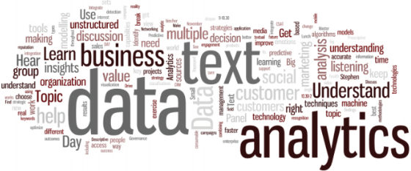
Neti Sheth
Zhenlong Wu
Soumya Roy
Raghav Dasari

Slide 2
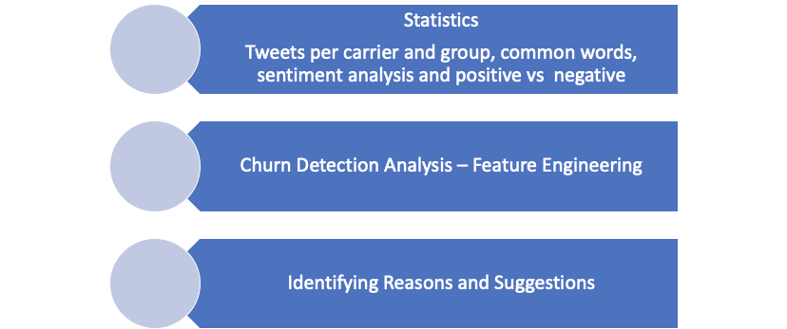



Questions

Slide 3
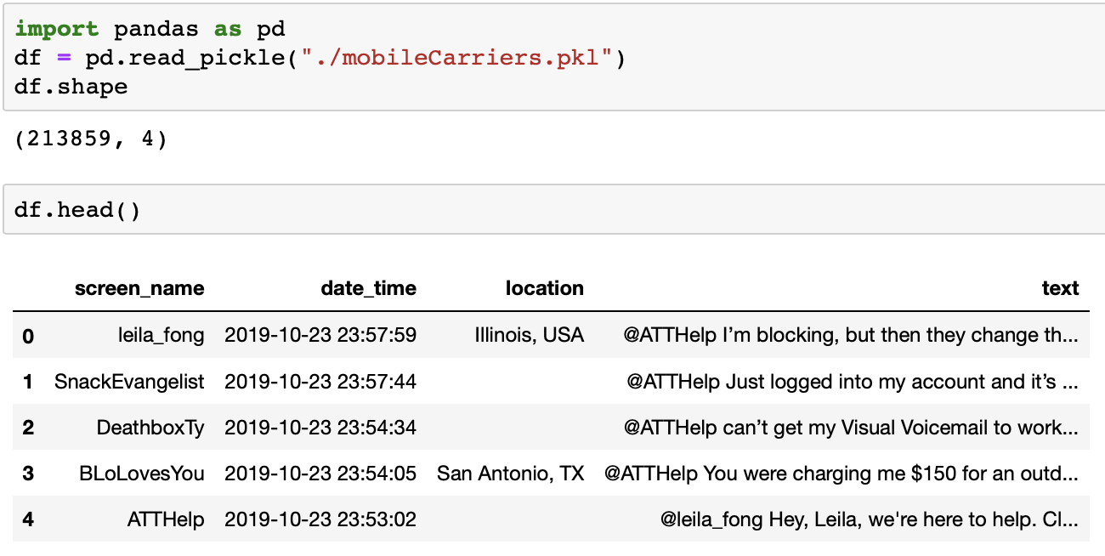
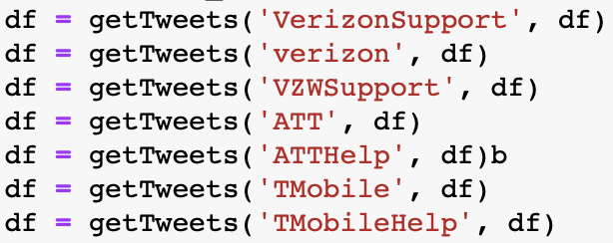
Data Source and Goal
Through the customer sentiment analysis of the three major Carriers, implement churn detection and find out the reasons for the customer wants to churn.
Data Source: 213859 Tweets so far, from 2019-10-9 to 2019-10-23

Slide 4
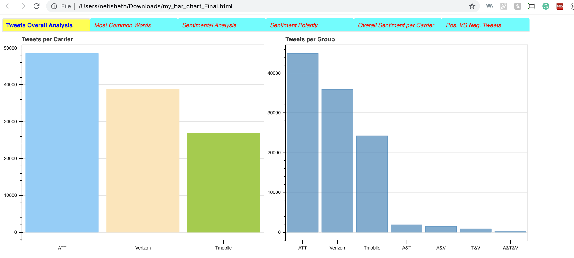
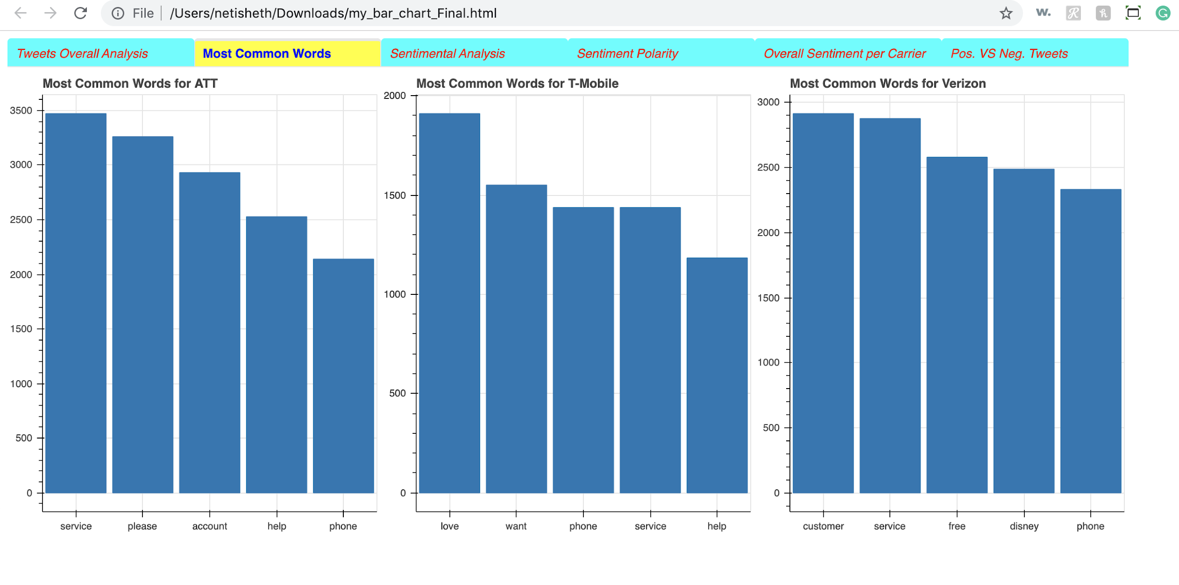
Statistics of the data for ATT, Verizon and TMobile
Python Dashboard:

Slide 5
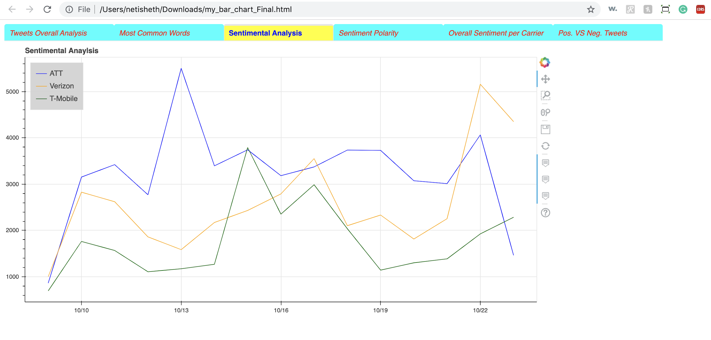
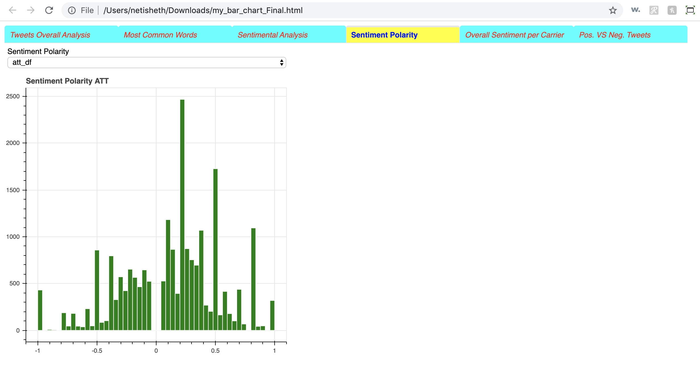
Statistics of the data for ATT, Verizon and TMobile
Python Dashboard:

Slide 6
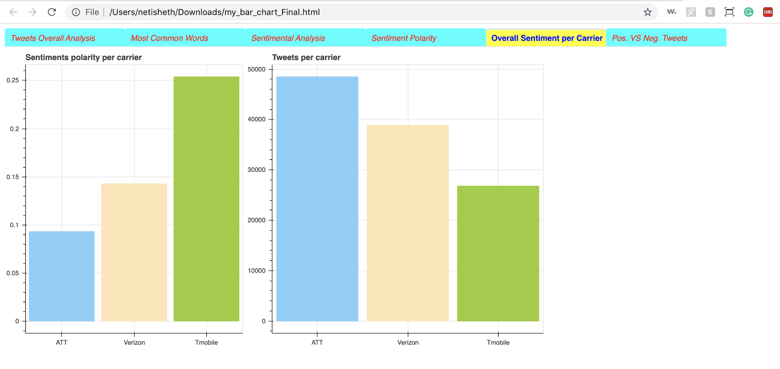
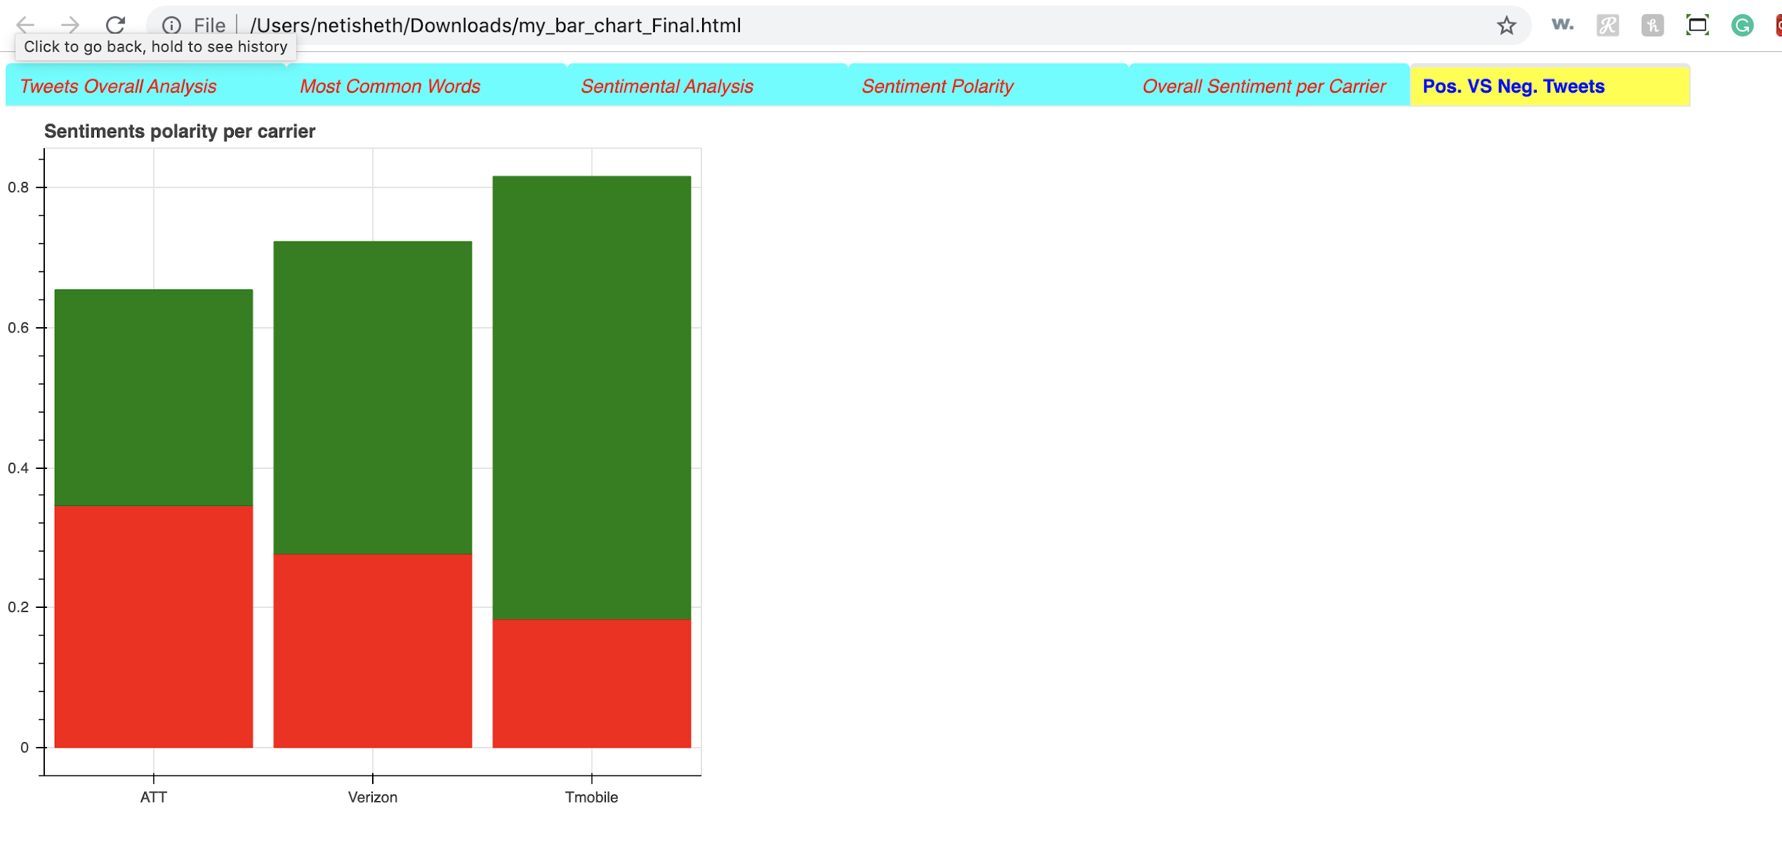
Statistics of the data for ATT, Verizon and TMobile
Python Dashboard:

Slide 7
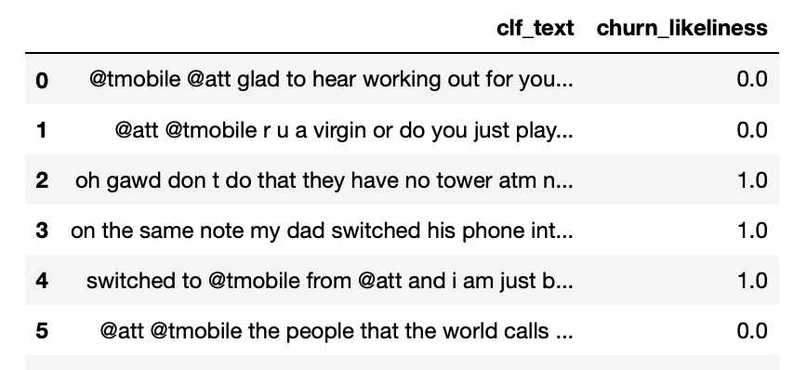
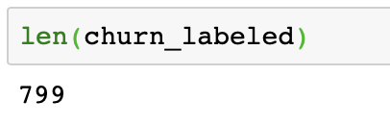
Label -- the most challenging part
How did we label the tweets?
Manual
Using Models
What are labels and their representation? 0 , 1

Slide 8
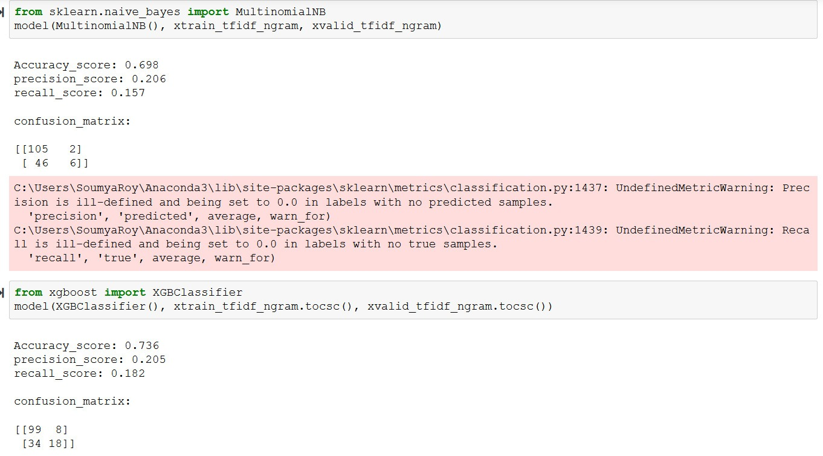
Label -- using models

Slide 9
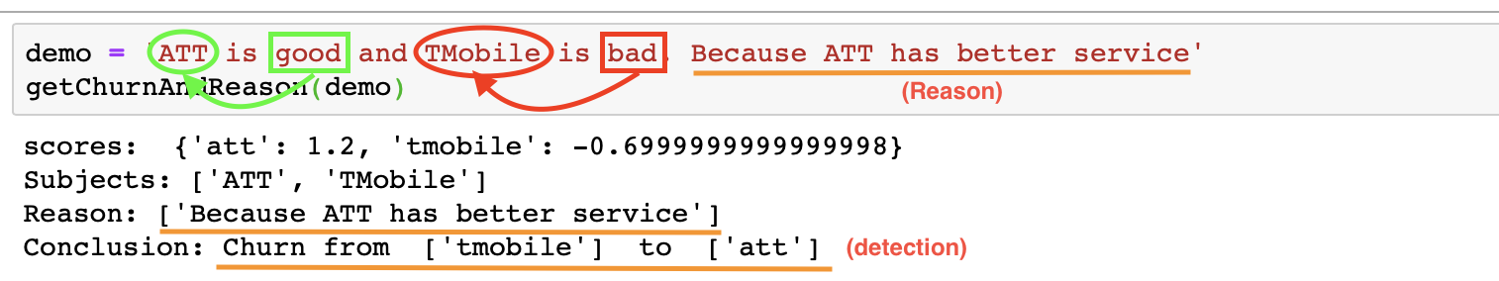
Automatic churn detection
Rule based Example

Slide 10
Some example of rule
switch from … to …
switch / transfer / try / free / come
Like … / hate …
and, but
Disney for Verizon
sentiment score
...
Go to Jupyter Notebook

Slide 11
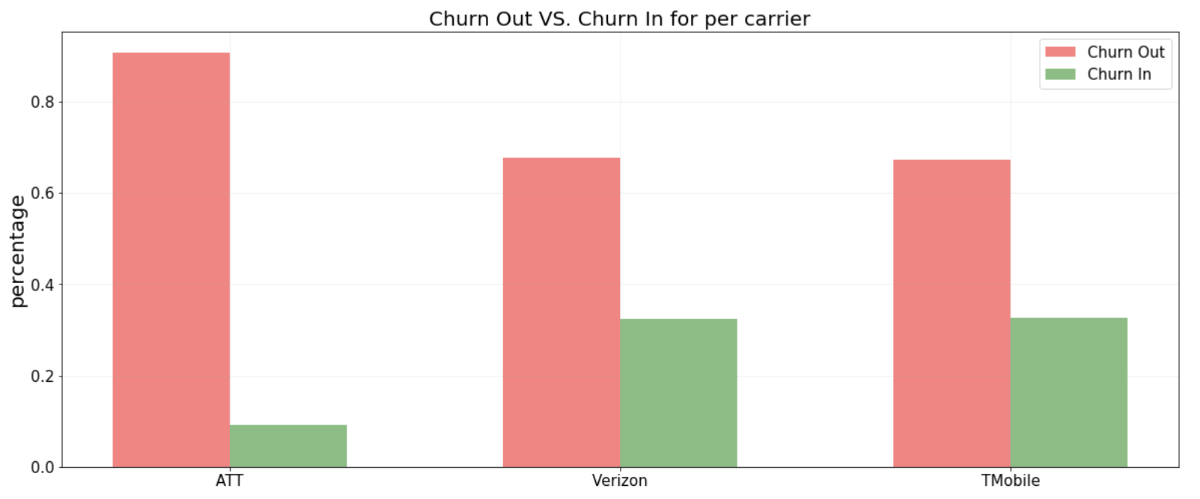
Churn Analysis --
Churn rate and Acquisition rate

Slide 12
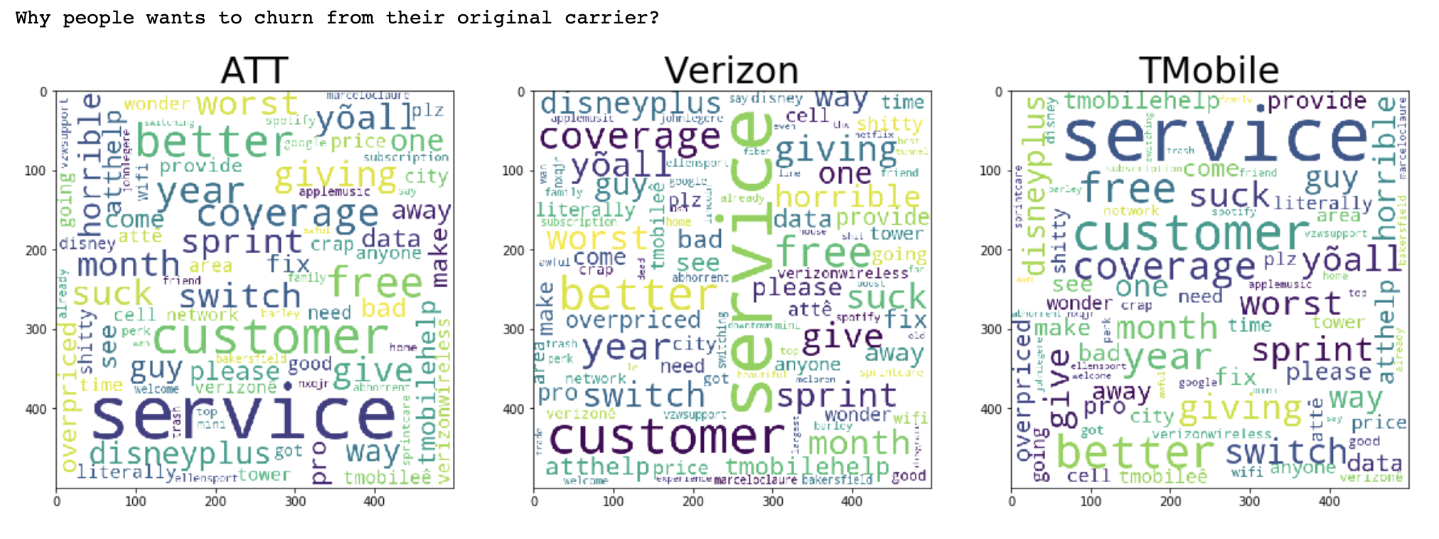
Reasons for churn
Reason of Moving out:
ATT
Verizon
TMobile

Slide 13
Suggestions
ATT:
Fix the data service in Bakersfield CA and Queens NY.
Abhorrent customer service.
TMobile gives it's customers free Netflix, and verizon is giving their customers a year of @disneyplus
Their price start at about $90
4 yrs of over paying for shitty service and expensive rate plans!
Verizon:
Overpriced
ATT and Verizon prices are pretty high
@verizon literally has the worst customer service.
I have horrible cell reception or no service
T-Mobile
horrible with customer service
they have no coverage in my area
have the worst Data Service in Bakersfield CA

Slide 14
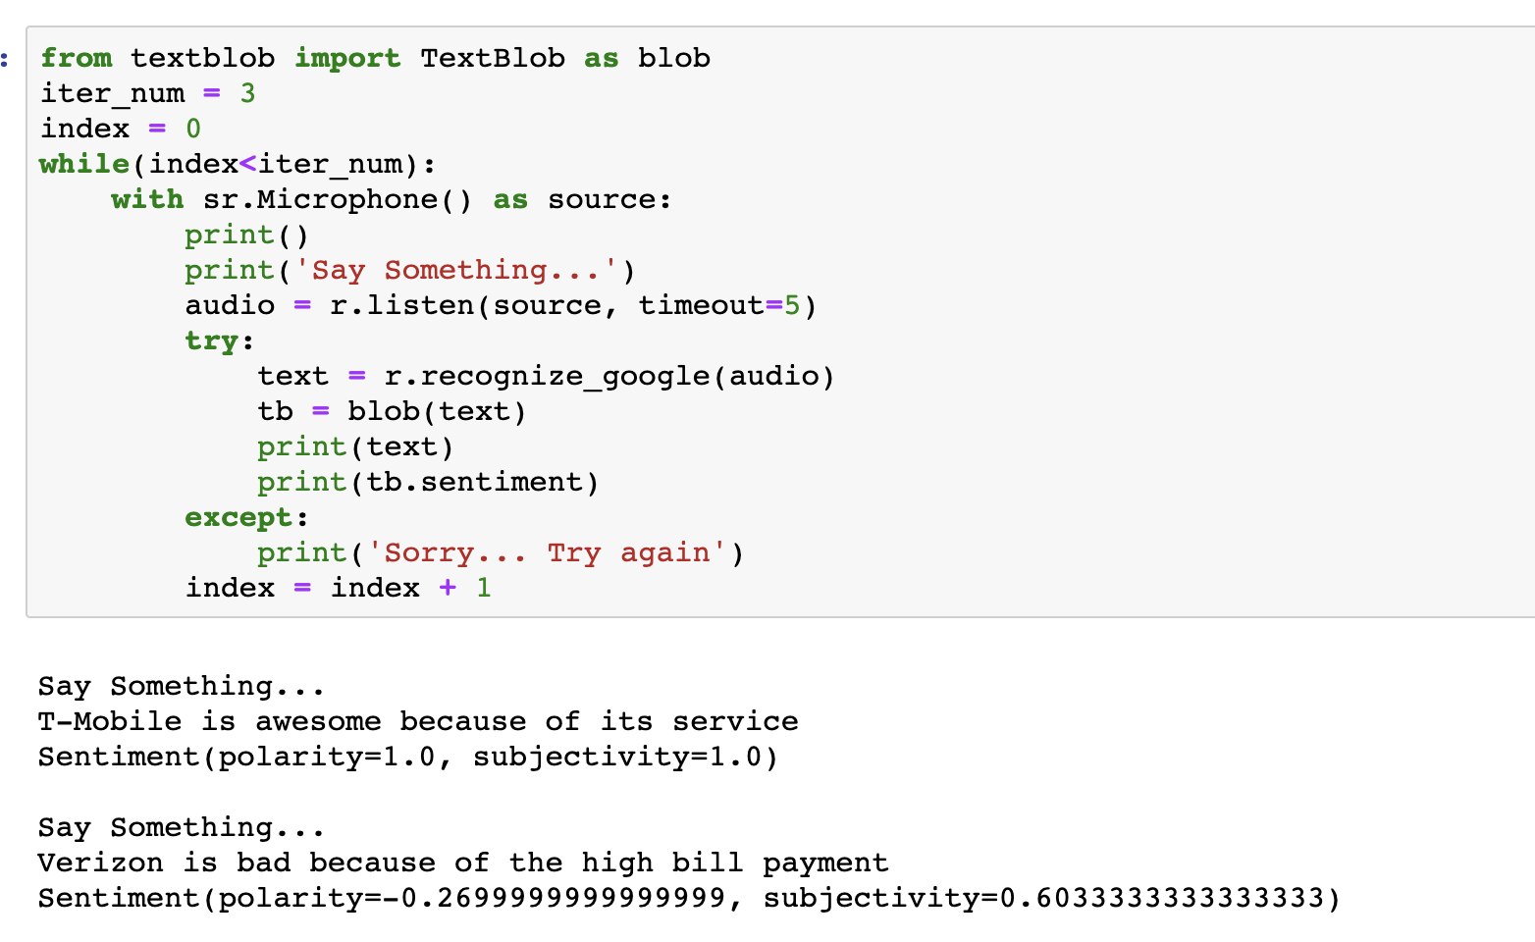
Sentiment Analysis from speech

Slide 15
Thank you

